Slide 1


SWAMY VIVEKANANDHA VIDHYA SAMSTHE ®
KUMADVATHI FIRST GRADE COLLEGE SHIKARIPURA
Project on:
Convert the tempreture units
Submitted by
Ramya H S
Anjum Doddmani
Thasmiya
Harini Raikar
Under the Guidance of
Prashanth Kumar sir
Department of Bachelor of
computer science
Kumadvathi first grade college
Shikaripura

Slide 2
contents
Aim
Introduction
Objectives
Features
Formulas
Algorithm
Flowchart
Program
Conclusion

Slide 3
AIM
The aim of this project is to convert temperature values between Celsius and Fahrenheit. It helps users to easily understand temperature in different units. It reduces manual calculation errors and gives quick results.

Slide 4
INTRODUCTION
This mini project is developed to create a simple program that converts temperature between Celsius and Fahrenheit. The program takes input from the user, performs the conversion using standard formulas, and displays the result as output.
The program is designed using functions, which makes the code simple, reusable, and easy to understand. Each function is used to perform a specific task such as converting Celsius to Fahrenheit or Fahrenheit to Celsius.
This project is helpful in real life as temperature conversion is commonly needed in weather reports, cooking, and scientific calculations. By using this program, the conversion process becomes faster, accurate, and easy. It also helps beginners to understand basic programming concepts and improves problem-solving skills.

Slide 5
OBJECTIVES
To design a simple temperature conversion system
To convert Celsius to Fahrenheit and Fahrenheit to Celsius
To understand the use of formulas in programming To develop basic HTML and JavaScript skills

Slide 6
Features
Convert Celsius to Fahrenheit
Convert Fahrenheit to Celsius
User input
Display Accurate Result
Easy to use
Fast Calculation
Menu Option
Repeat Option

Slide 7
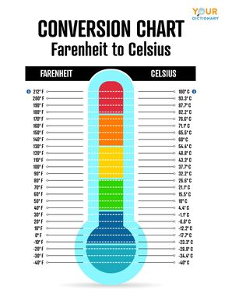
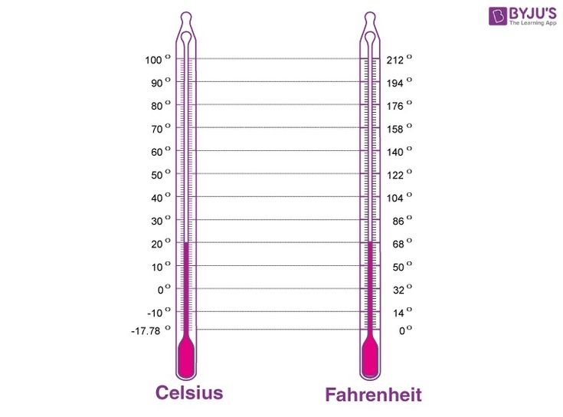
FORMULS
fahrenheit to Celsius
= (c * 9/5) + 32
CELSIUS TO FAHRENHEIT
c = (f - 32) * 5/9

Slide 8
ALGORITHM
Start
Enter the temperature value
3. Display options for conversion:
a) Celsius to Fahrenheit
b) Fahrenheit to Celsius
4.Read the user’s choice
5. If the choice is Celsius to Fahrenheit, then
F = (C × 9/5) + 32
6. Else if the choice is Fahrenheit to Celsius, then
C = (F − 32) × 5/9
7. Display the converted temperature
8.Stop

Slide 9
Start
FLOWCHART
Enter Temperature
Select Conversion 1. C → F
2. F → C
Choice == 1 ?
F = (C×9/5) + 32
Display Result (F)
End

Slide 10
<!DOCTYPE html>
<html>
<head>
<title>Temperature Converter</title>
</head>
<body>
<h2>Temperature Converter</h2>
<input type="number" id="temp" placeholder="Enter temperature">
<br><br>
<button onclick="toFahrenheit()">Convert to Fahrenheit</button>
<button onclick="toCelsius()">Convert to Celsius</button>
<p id="result"></p>
<script>
function toFahrenheit() {
let c = parseFloat(document.getElementById("temp").value);
let f = (c * 9/5) + 32;
document.getElementById("result").innerHTML = "Fahrenheit: " + f;
}
function toCelsius() {
let f = parseFloat(document.getElementById("temp").value);
let c = (f - 32) * 5/9;
document.getElementById("result").innerHTML = "Celsius: " + c;
}
</script>
</body>
</html>

Slide 11
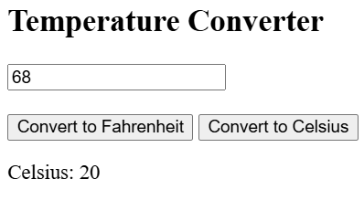
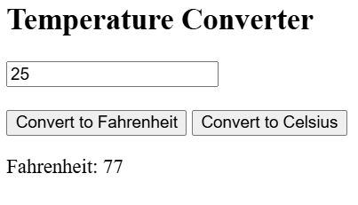
OUTPUTS

Slide 12
Conclusion
This program is useful for converting the tempretures and also it is helps users avoid manual calculation
Its easy to gives correct result Quickly this program helps to saves time and is useful in daily life

Slide 13
THANK YOU

